Slide 1
BHEEMA CNC
MANUFACTURING FACILITY
SHOP FLOOR
CERTIFICATES AND AWARDS
About
SAMPLES

Slide 2
1.We are equipped With Five Vertical Machining Centers
(VMC) , Moreover we have Measuring instruments up to 300 mm
like GMT Granite surface table, Digital Height gauge ,Digital Verniers ,
Micrometer and Bore gauges, Air gauges.
2. We are capable of designing and manufacturing of fixtures ,Cutting
tools and Gauges used in CNC machine shop.
3 .AN ISO 9001 – 2015 (From TUV SUD) & 100 PPM Certified
Company (From HYUNDAI).
4. Twenty years experience in CNC machine Shop.
5. GST and ESI Registered Company
CERTIFICATES AND AWARDS
MANUFACTURING FACILITY
SHOP FLOOR
SAMPLES
About

Slide 3
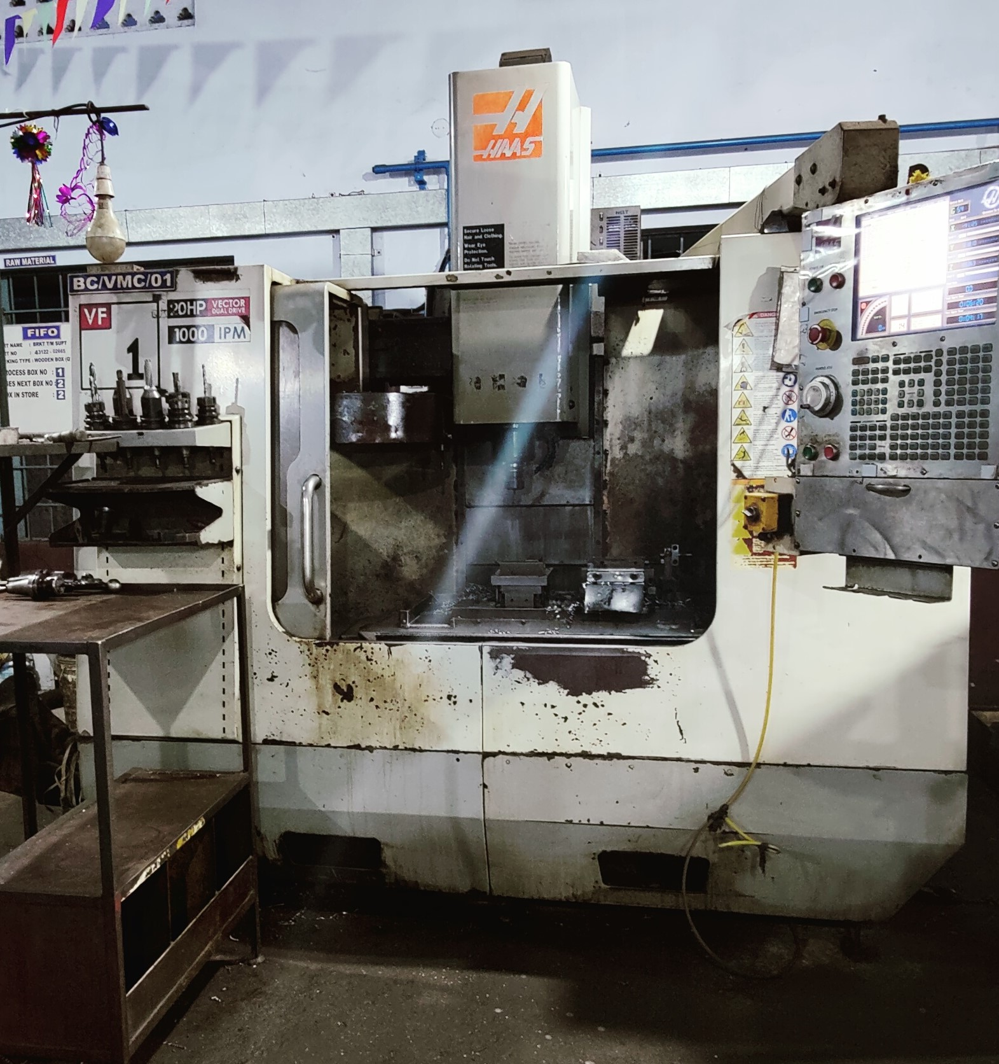
CERTIFICATES AND AWARDS
SAMPLES
SHOP FLOOR
About
MANUFACTURING FACILITY
MACHINE NAME :- VMC
MAKE & MODEL :- HAAS VF1 (USA)
CONTROL :- HAAS
CAPACITY :- 610 X 410X 510 MM

Slide 4
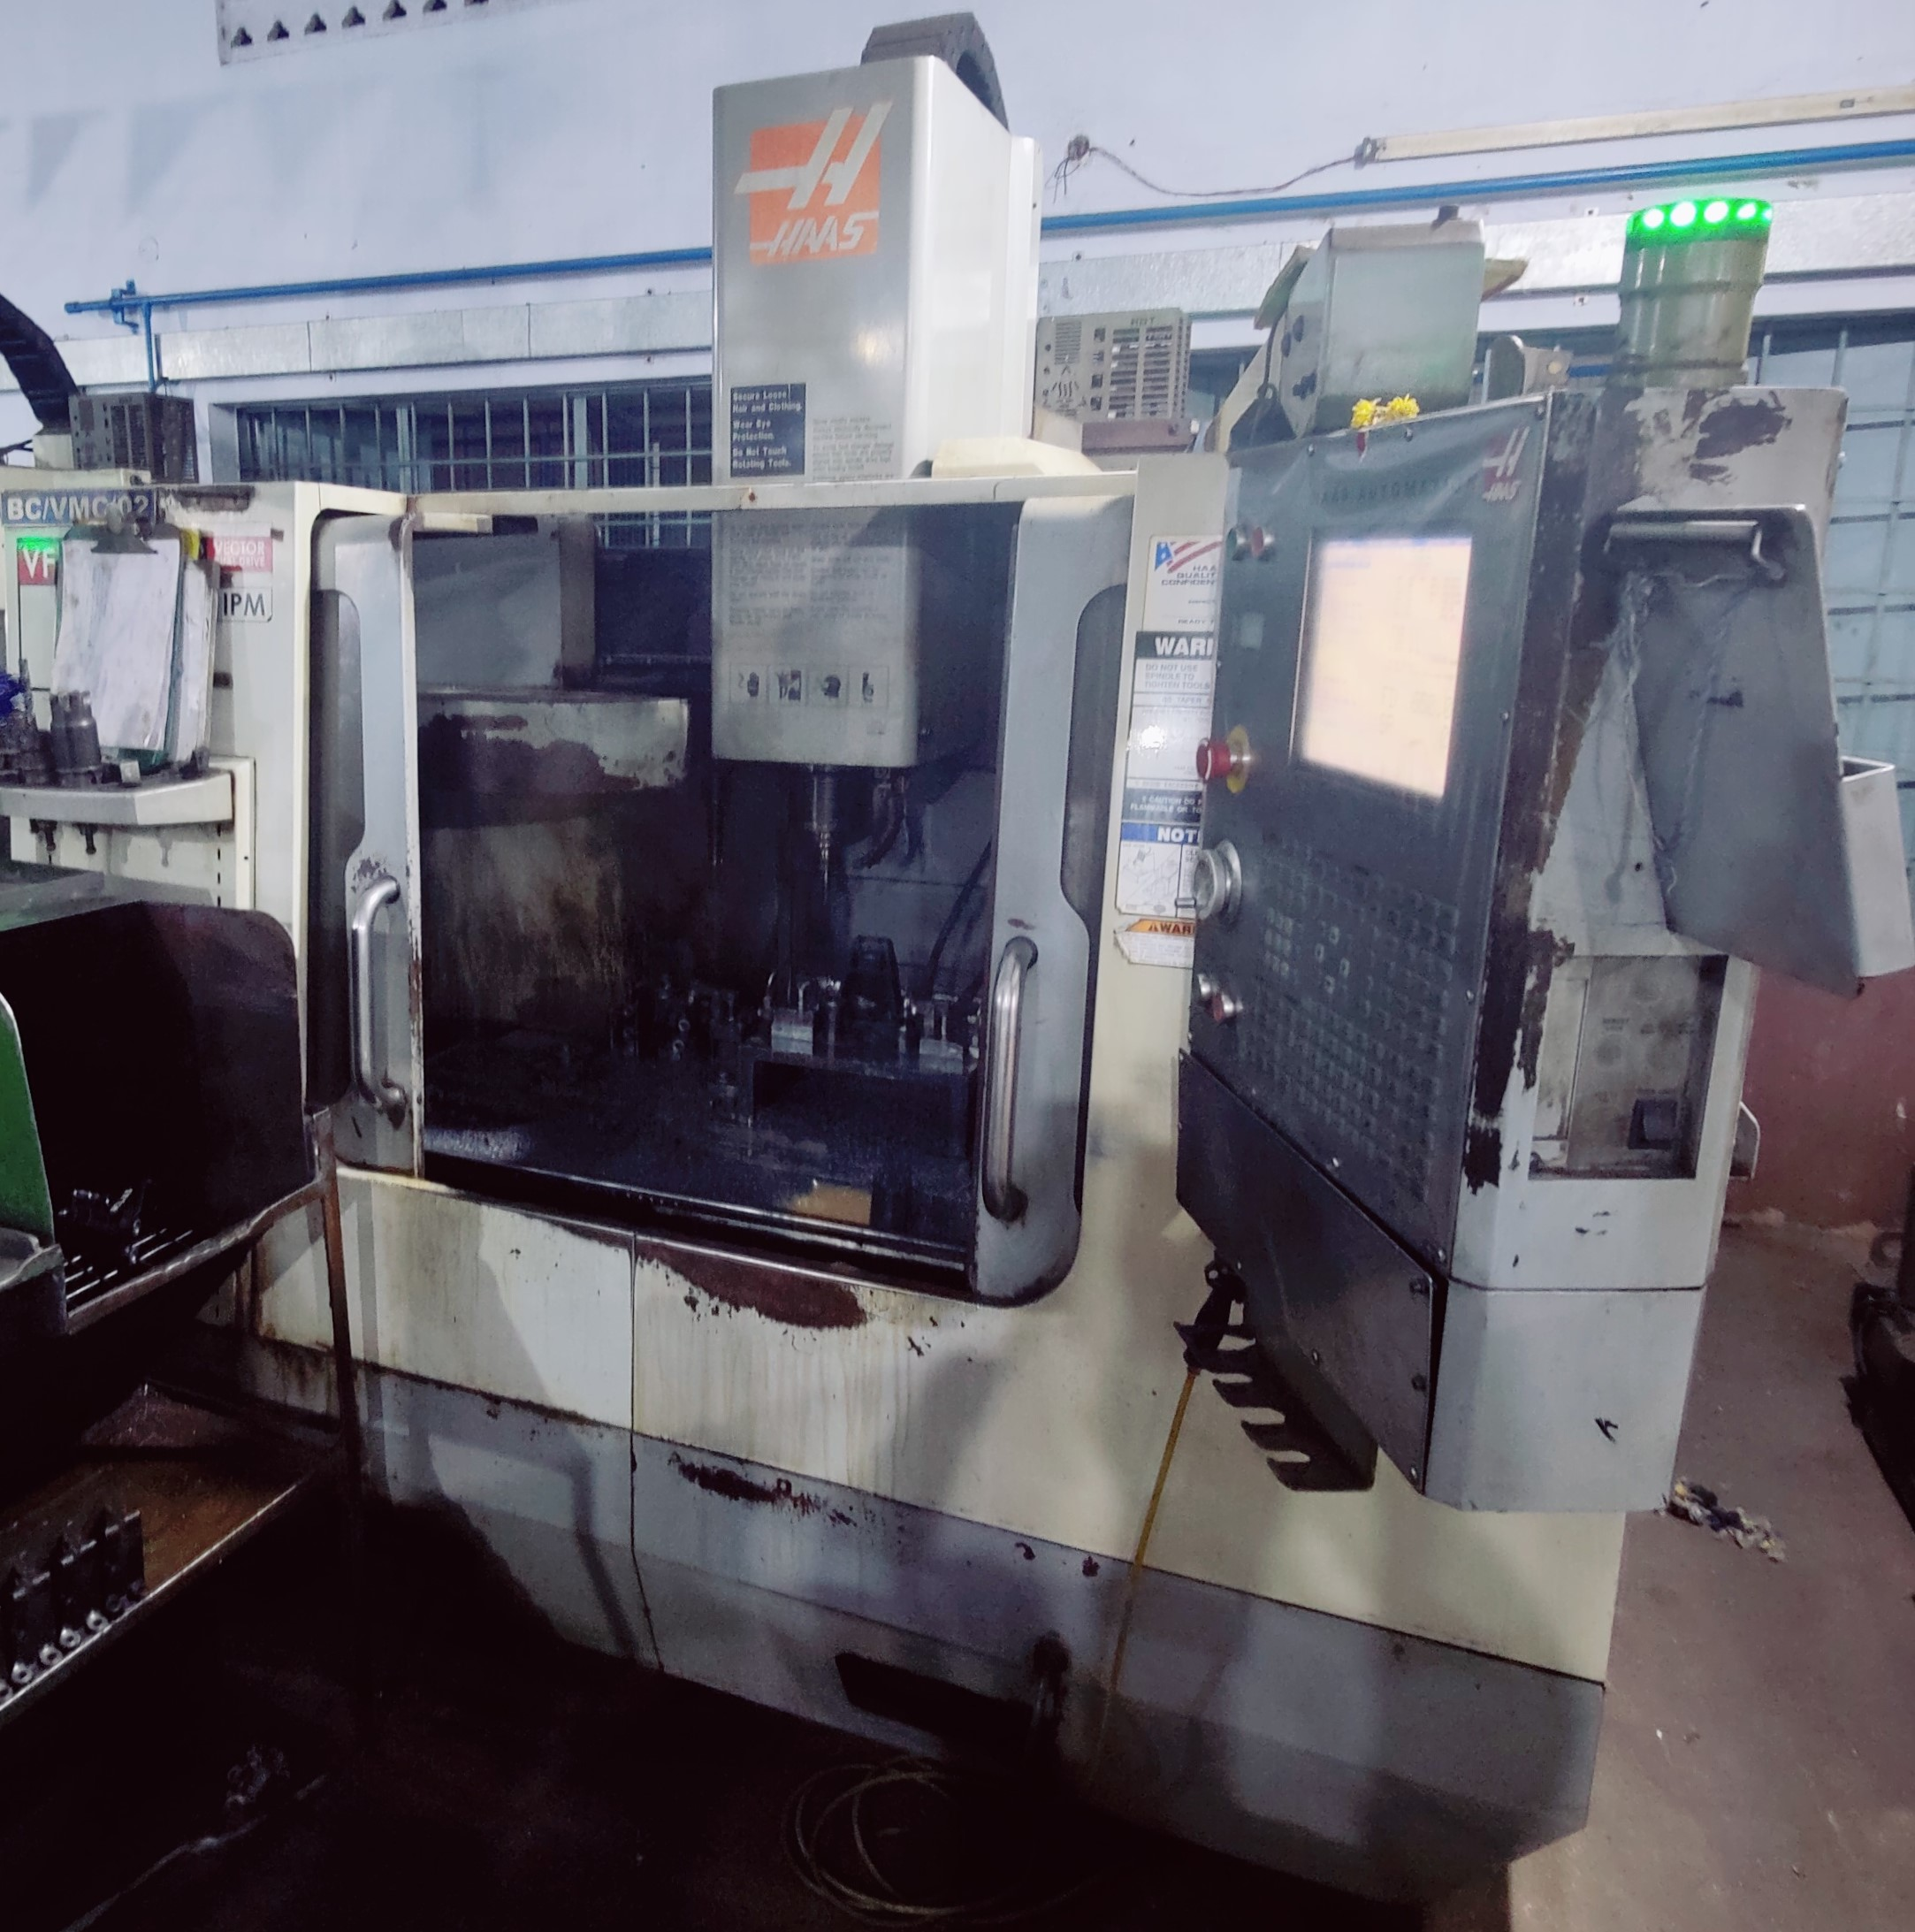
SAMPLES
CERTIFICATES AND AWARDS
SHOP FLOOR
About
MANUFACTURING FACILITY
MACHINE NAME :- VMC
MAKE & Model :- HAAS VF2 (USA)
CONTROL :- HAAS
CAPACITY :- 762 X 410 X 510 MM (Travel)

Slide 5
Departments | People
Human and resources | 3
Administration | 10
Research and development | 20
Production | 100
About

